Slide 1

Implementing Open Access 2020 at SNSF
Policy, funding, processes

Slide 2

Why open access is important to SNSF
SNSF strives to
Support high-quality research
Align research funding with the researchers’ needs
Support the spread of knowledge in society, economy and politics
Open access connects to all three of these goals
increase visibility of the funded research
increase availability of needed publications
lift barriers to dissemination beyond academia

Slide 3

Open Access at SNSF
Important steps
2006: signing of Berlin Declaration
2008: Mandatory self-archiving of articles
2013: Funding gold OA for articles
2014: Expansion of self-archiving mandate to books
2014: SNSF signs DORA Declaration
2016/2017: Swiss National Strategy on Open Access
2018: New OA regulations come into effect

Slide 4

Core principles behind OA2020
Remove reasons not to publish in open access
Provide funding regardless of format (articles, books, book chapters)
Extend funding beyond the duration of grants
Lift upper limit for APCs for the time being
Yet preserve freedom to choose where to publish
Green road and self-archiving still fulfill mandate
Hybrid publishing fulfills mandate but is not funded by SNSF

Slide 5

Measures taken - Overview
Key areas:
Changes to OA policy
Incentives and support
Compliance and controlling
Communication

Slide 6
1. Changes to OA policy
Most important:
Funding for Gold OA to any format (articles, books, book chapters)
Introduction of service-oriented processing charges (BPC, BCPC)
Shorter acceptable embargo period for Green OA to books
12 instead of 24 months
No exceptions from OA requirement for articles any more

Slide 7
2. Incentives and support
Most important:
Dedicated platform within mySNF to apply for funding
No matter when the respective grant has ended
As easy as possible for researchers
Upper limit for APCs not applicable for the time being
SNSF will pay $5300 for an APC in Science Advances (CC-BY) or $5200 in Nature Communications
Signal to the research communities that SNSF takes their reservations seriously

Slide 8
3. Compliance and controlling
Most important:
Monitoring development of OA status of publications resulting from SNSF funding
Are we generally moving in the right direction?
Contribute to transparency by supplying data to OpenAPC
Monitor grantees’ compliance with OA requirement
Feedback to researchers, encourage reflection
Turn OA behaviour visible (P3, upcoming data portal)

Slide 9
4. Communication
Most important:
Improve information on SNSF website and in mySNF
OA is complex, work towards better understanding
Change phrasing to emphasize OA is the standard, not an option
Keep informing and discussing the topic until 2020 and beyond
In parallel to practical measures being taken
Flexible and including all important stakeholders

Slide 10

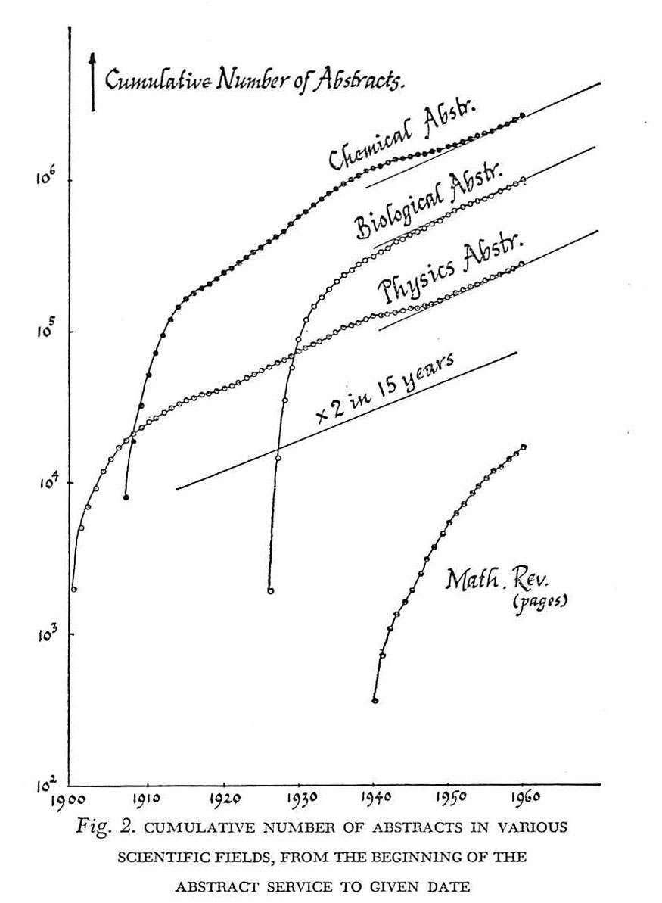




Article Processing Charges APCs

Slide 11

APCs: Requirements
Participation requirements:
Articles must be published in a purely open access journal with peer review and of assured scientific quality
Applications can be submitted by grantees or by members of the project team
One of these persons must be mentioned as author
The article must include an acknowledgement of SNSF funding
Co-Funding: The SNSF funded at least 50% of the research on which the article is based

Slide 12
APCs: Process
Implementation:
Costs can be applied for all year round via mySNF
There is no upper limit for the number of publications per grant
Either
Upload the publisher's invoice to mySNF when submitting application
SNSF pays the charge directly to the publisher after a formal check
Or
Use a different source to settle the invoice
Submit application up to 6 months after publication date via mySNF
Provide proof of payment
Have amount reimbursed

Slide 13

Book Chapter Processing Charges BCPCs
Book Processing Charges BPCs

Slide 14
Book Chapter Processing Charges BCPCs: Requirements
Participation requirements
Book chapters must be made accessible immediately, free of charge and without any restrictions (gold OA).
Applications can be submitted by grantees or by members of the project team.
The book chapter must be the product of an SNSF-funded project.
The book chapter must include an acknowledgement of SNSF funding.
Applications for BCPCs must be based on the version of the reviewed book chapter that has been approved by the publisher.
Until the end of 2019, the SNSF will accept BCPC applications even if the anthology as a whole was not published in an OA version.

Slide 15
BCPCs: Implementation
Implementation
Process is similar to APCs.
Only the actual costs and fees incurred will be reimbursed.
The SNSF accepts the publisher's peer-review decision.
BCPC applications are processed within a short time-frame via the OA platform.

Slide 16
Book Processing Charges BPCs
Requirements for applicants (Art. 5)
Who submits the application?
Monographs: the author
Anthologies: the editor or at least one member of the editorial team
Who is eligible to submit an application?
Publication resulting from SNSF project | "Independent" publication not linked to the SNSF
Grantees and project teams -> Applications can also be submitted after the end of the project | Applicant meets the general requirements pursuant to Art. 10 of the Funding Regulations Doctoral thesis/habilitation: thesis defence at a Swiss university

Slide 17
BPCs: Books & Costs (Art. 3, 11)
Type of books covered
Monographs (incl. doctoral theses and habilitations as comprehensive, scientific, peer-reviewed books)
Anthologies
Costs covered
Costs related to the production of the first digital copy
Actual costs for publisher services
quality control incl. Peer review; editing and/or proofreading af the manuscript; typesetting, layout and cover, image processing and image reproduction rights; marketing and distribution; provision of the conventional, digital and open access specific metadata; publication of the OA book an the publisher’s website.

Slide 18
BPCs: Grant amount (Art. 11)
Module | Grant amount
Basic module* | Up to CHF 15’000 for a quotable OA publication up to 750’000 characters
Supplementary module (SM) Higher number of characters | Lump sum CHF 3’000 for up to 250’000 additional characters Lump sum CHF 5’000 for more than 1 Million characters
SM Layout und image rights** | Additional max. CHF 5’000
SM Enriched E-Book** | Additional max. CHF 5’000
SM Foreign language proofreading** | Additional max. CHF 5’000
* Costs according to the open access offering of the publisher.
** Supplementary module for demonstrable additional costs. The publisher’s quotation
or an invoice must be submitted.

Slide 19
BPCs: Guidelines for the peer-review process
(Art. 9)
Publisher’s responsibility
At least 1 external, independent and meaningful review in written form and a documentation of the peer-review process conducted.
Independent and external:
    Reviewers are not involved in selecting the manuscript and producing the publication
    Reviewers do not have any conflicts of interest in relation to the persons involved in a publication
    Meaningful:
    Reviewer assesses scientific quality of publication.
    Review is based on a full text version, not on a proposal.

Slide 20
BPCs: Further provisions (Art. 16, 17)
License: OA books must be made available with a cc-license. At least CC-BY-NC-ND is required.
DOI: OA books must be made available with a DOI. For anthologies, metadata for each individual contribution need to be provided.
Metadata: differentiation between conventional, digital and open-access specific metadata is demanded.
Deposition:
  by publisher: website
  by author / editor: institutional or disciplinary repository
  by SNSF: forwarding metadata to the Swiss National Library (archiving in the long term) and the OAPEN Library (international visibility)

Slide 21
BPCs: Implementation
Process
Applications possible since April 2018 & all year round
Application must be based an the manuscript checked by the publisher and declared fit for publication
Evaluation by SNSF within 2 months' time
The amounts are paid directly to the publishers
Publication within 6 months after payment
Payment only if metadata are made available

Slide 22
Transitional provisions - Articles
Articles in scientific journals:
Either: already awarded grants towards OA costs can be used as stipulated in the regulations in force at the time.
Or: application can be submitted for covering cost of OA publications via OA platform and the already awarded sum can be used for other project expenses.

Slide 23
Transitional provisions - Books
Scientific book publications:
Either: apply for BPC based on new regulations and reap the benefits. Pay back funds already awarded for book publications.
→ Higher grants, more comprehensive publishers' services, publication also possible after end of project
Or: reallocation of the grant as a BPC during the funding period of the project.
→ Publication in gold OA, immediately available as open access
Or: use for a digital publication based on the previous regulations by the end of the project.
→ Work is only available as open access after 24-month embargo period

Slide 24
Internal procedures
Requests for articles (APC) and book chapters (BCPC) have to be submitted 6 months after the publication date at the latest
Verification whether an article is Gold OA is primarily based on the DOAJ
In order to keep track of the expenses for OA and transfer them to OpenAPC, grantees should indicate their OA processing charges, particularly if they used it in scope of the awarded grants.

